Slide 1
MEDIA CAMPAIGNS FOR SOCIAL CHANGE
TEMPLATE FOR PARTICIPANTS

Slide 2
NAME OF PARTICIPANT TOPIC OF CAMPAIGN: NAME OF CAMPAIGN

Slide 3
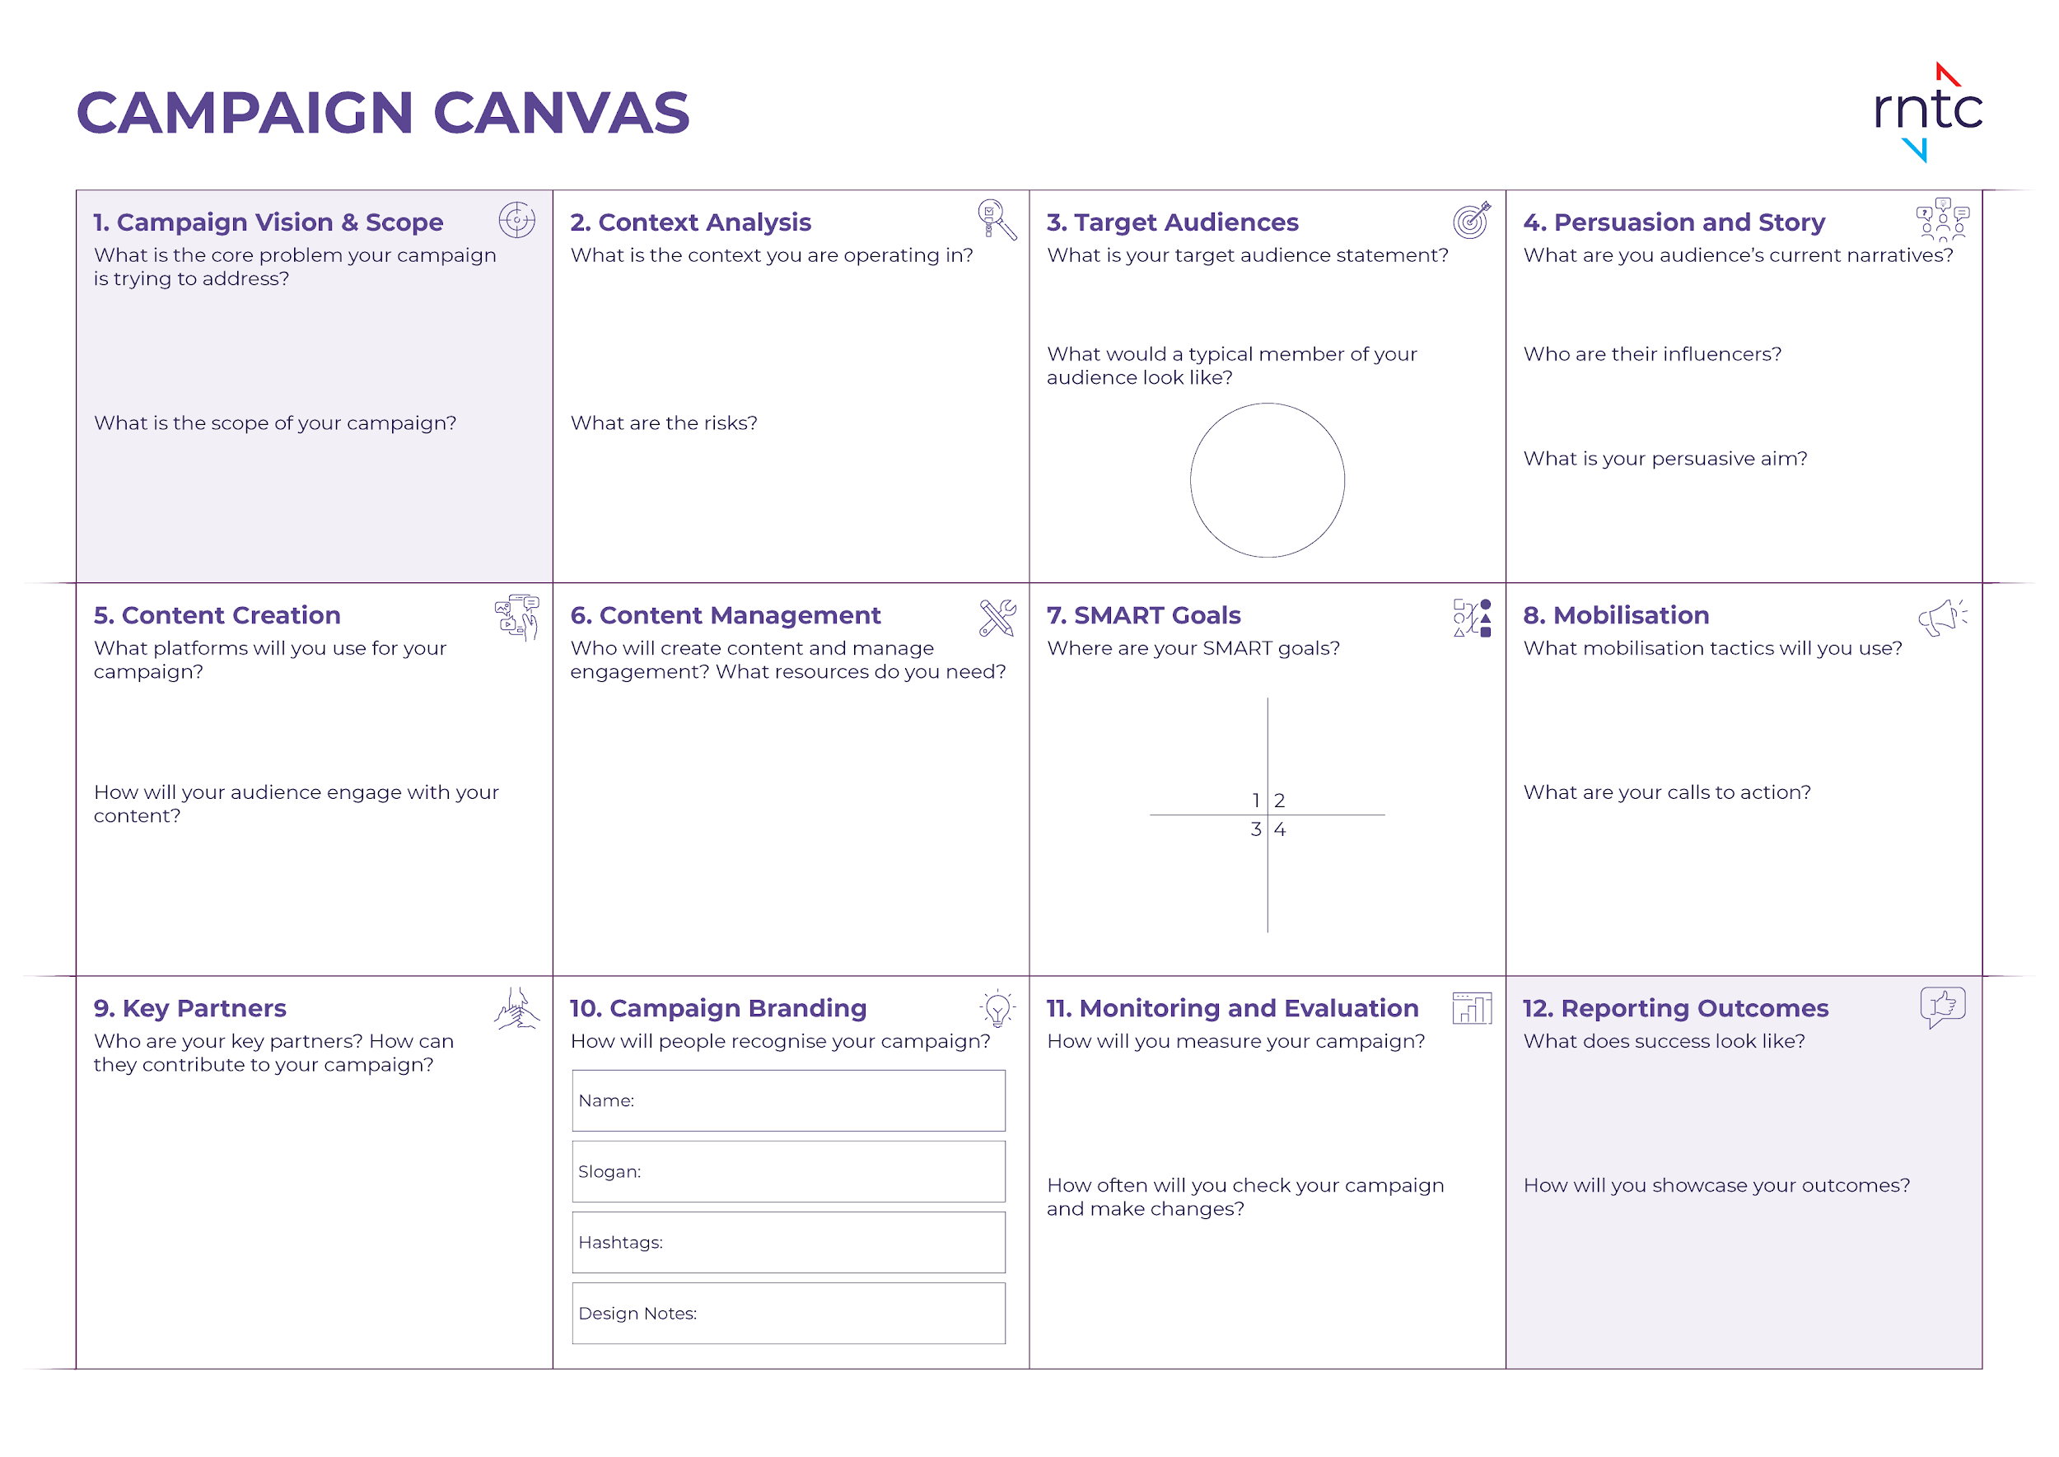

Slide 8
Emotions
Emotions
Agreed
Realities
Emotions
Agreed
Realities
Agreed
Realities
Influencers
Influencers
Influencers
Agreed
Realities
Agreed
Realities
Emotions
Influencers
Influencers
Emotions
Influencers
Influencers
Agreed
Realities
Agreed
Realities
Emotions
Emotions

Slide 18
Thank you!

